Slide 1
SEO Performance Analysis

Slide 2
SEO Performance Analysis — Methodology
Section | What to write | Example
Data Sources | Mention where the dataset comes from | “Google Search Console keyword data + competitive rankings (France, Brazil, Italy, English markets)”
Tools Used | Show your tech stack | “Python (Pandas, Matplotlib, Seaborn), Google Colab / Jupyter Notebook”
Steps Performed | Bullet points for your workflow | 1️⃣ Loaded and cleaned dataset 2️⃣ Analyzed keyword performance (clicks, CTR, avg position) 3️⃣ Compared country performance 4️⃣ Identified high volume / low rank keywords 5️⃣ Benchmarked vs competitors 6️⃣ Summarized insights + recommendations
Goal of Analysis | 1 sentence | “Translate raw SEO data into actionable insights to improve organic search performance.”
.

Slide 3
Key Insights and Performance Highlights
Country | Clicks | CTR | Avg Position | Key Takeaway
FR | 25 K | 3.2 % | 6.1 | High visibility → low CTR = meta tag improvement
BR | 9 K | 6.5 % | 5.4 | High engagement → expand Portuguese content
IT | 3 K | 2.1 % | 8.3 | Underdeveloped market → new localized pages

Slide 4
Top Keywords & Opportunities
Keyword | Avg Position | Search Volume | CTR | Comment
sports betting odds | 8.2 | 40 K | 3 % | Big volume but low rank → optimize content + links
live football scores | 7.5 | 35 K | 4 % | Strong potential if ranking improves
online betting bonus | 9.0 | 30 K | 2.7 % | Competitors ahead → needs backlinks

Slide 5
Competitor Gap Summary
30 % of keywords where competitors rank higher
Gap mostly in “bonus”, “predictions”, “odds” clusters
Competitors benefit from higher domain authority and fresher content

Slide 6
Business Recommendations
Action Plan & Expected Impact
Priority | Area | Recommendation | Expected Impact
1️ | Content Optimization | Update and expand pages for high-volume keywords (rank > 5) | Higher CTR and top 3 visibility
2️ | Technical SEO | Improve page speed + mobile friendliness on high-impression pages | Better user experience → CTR ↑
3️ | Backlinks & Authority | Target links for pages where competitors lead (“bonus”, “predictions”) | Close ranking gap
4️ | Localization | Expand Italian and Brazilian content clusters | Regional traffic growth
5️ | Keyword Expansion | Build new clusters around “live scores”, “odds”, “betting tips” | Long-term traffic increase

Slide 7
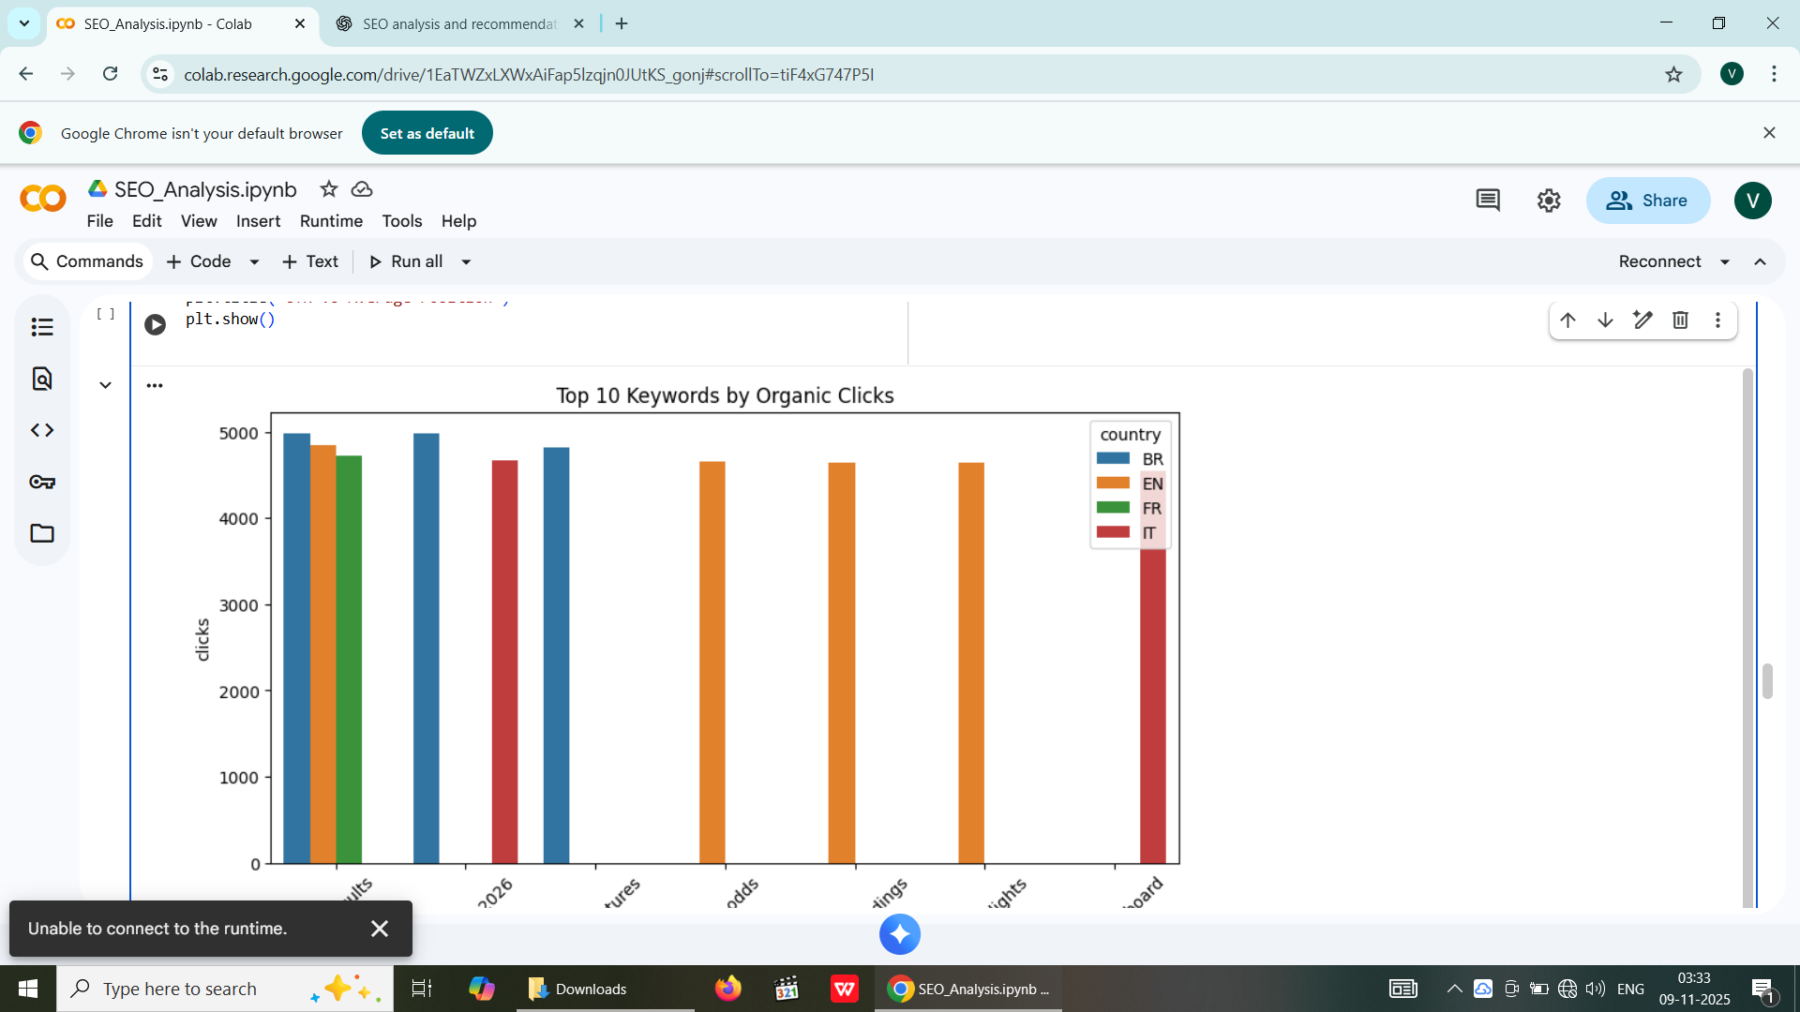

Slide 8
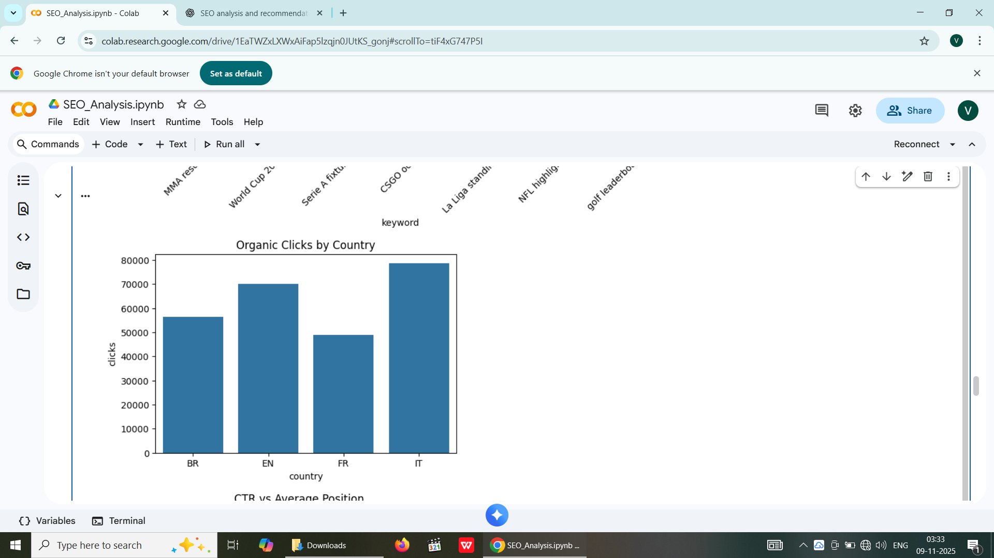

Slide 9
